Slide 1
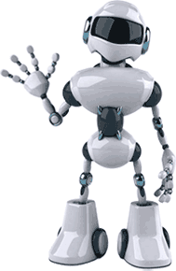
Introduction to Robotics

Slide 2

Tools Through Ages

Slide 3


Now Comes the Era of …

Slide 4


Slide 5
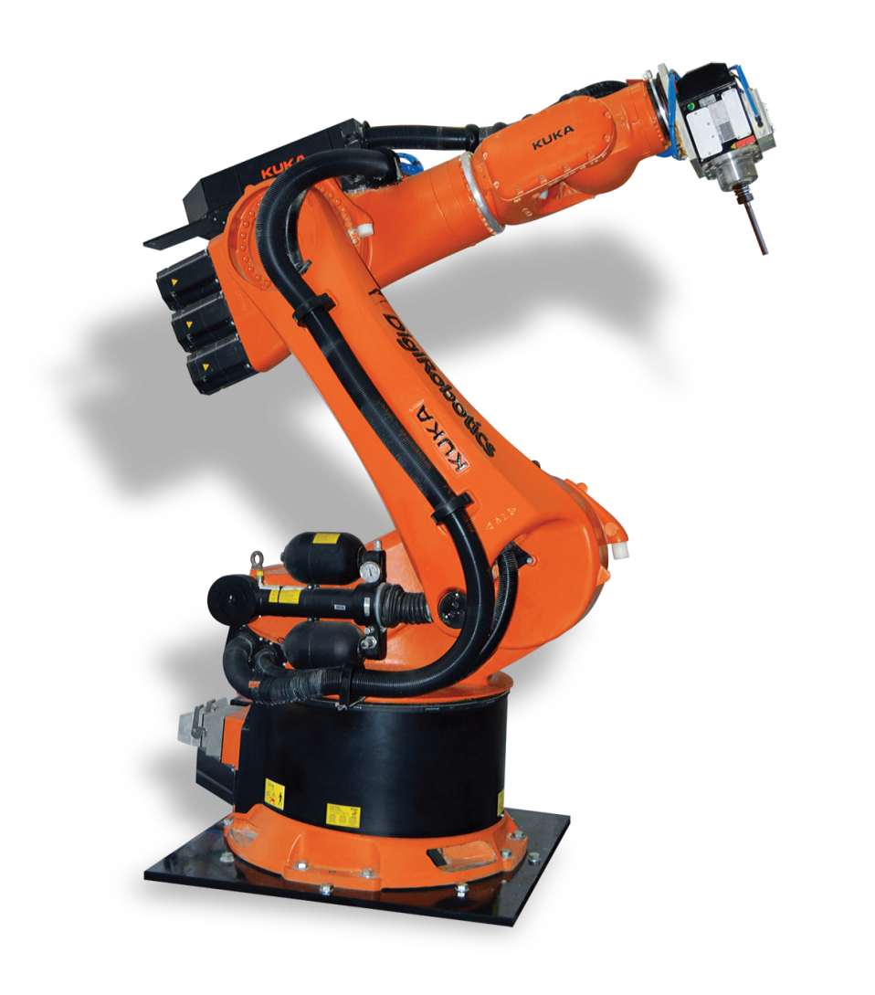
What is a Robot?

Slide 6

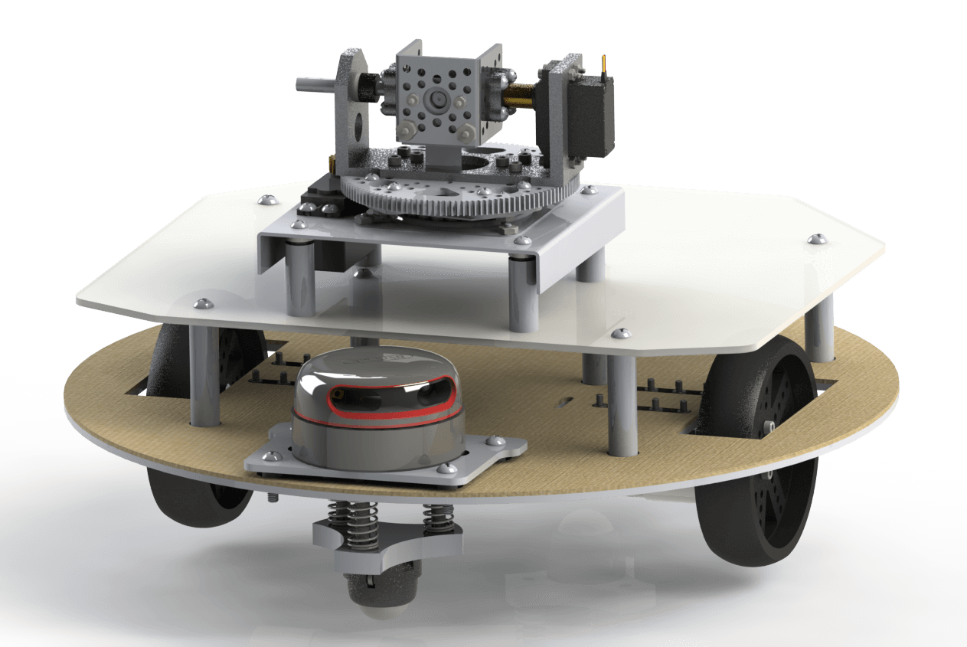
Mechanical

Slide 7
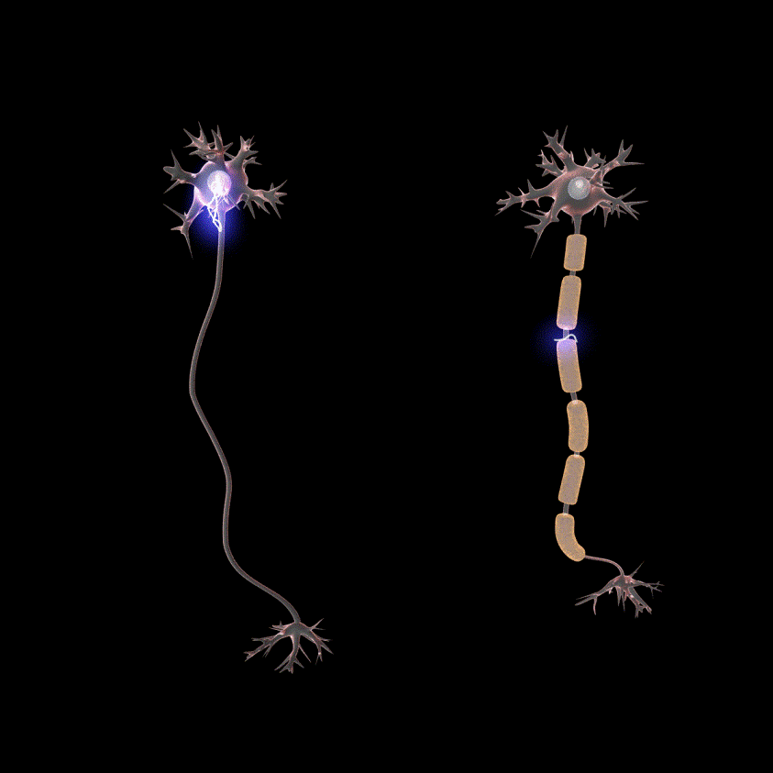
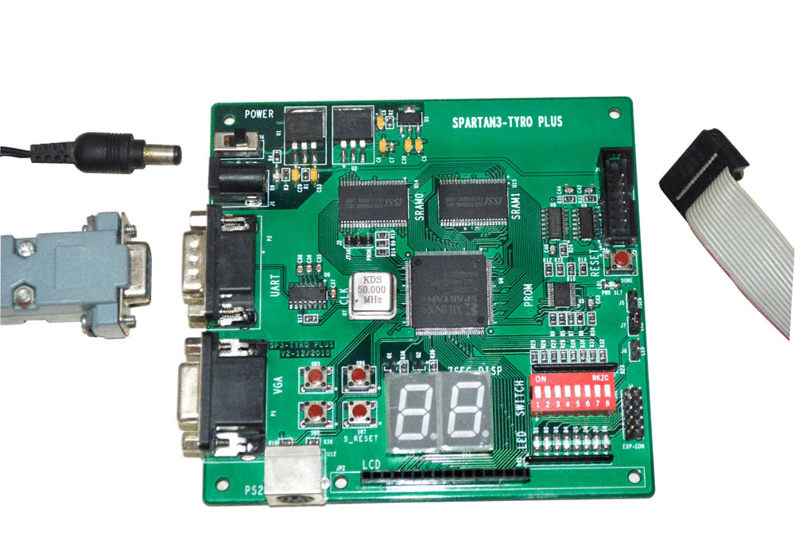
Electronics

Slide 8

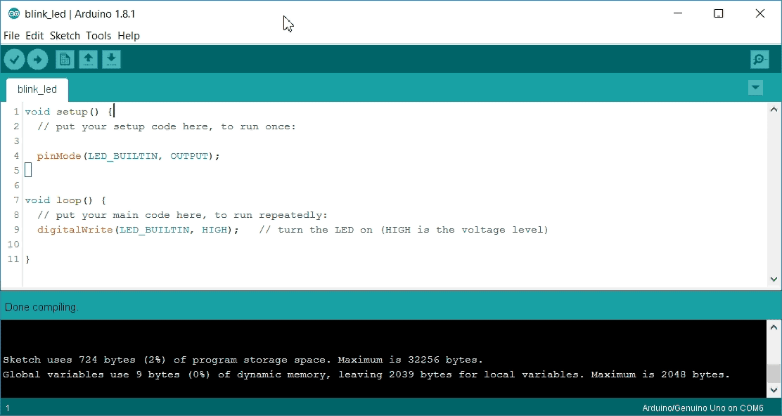
Computer Science

Slide 9
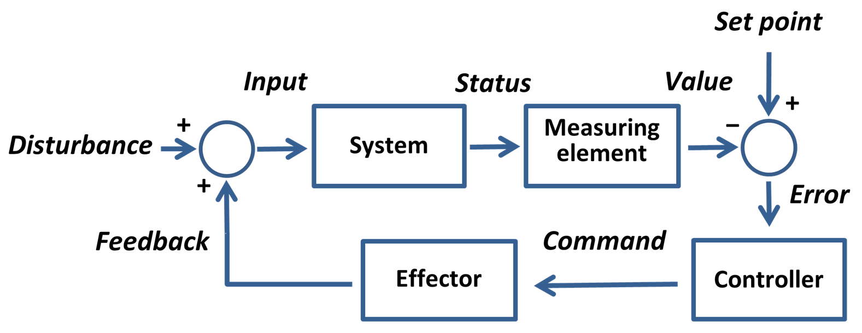
Robotic System

Slide 11
Robotics in India?
Precision Automation and Robotics India: Industrial Automation
Asimov Robotics: Solutions and consultancy
DiFACTO Robotics and Automation: Robot based automation systems in the fields of health and pharmaceutical, defense and aerospace, etc.
Grey orange: Advanced automation solutions
I2U2 Robot: Telepresence robotic companion
Mukunda foods: As the name suggest, automation in food industry
And many more…

Slide 12
How do I reach out to such companies?
Start with the basics…
Participate in university level robotic competitions: for example Robocon, IRC, WRO, etc.
Get hands-on project experience
LinkedIn: Your best bet!

Slide 13
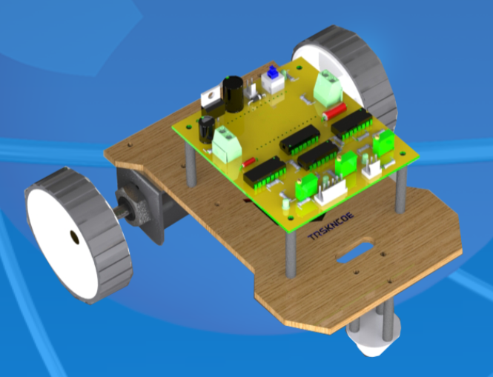

Slide 14
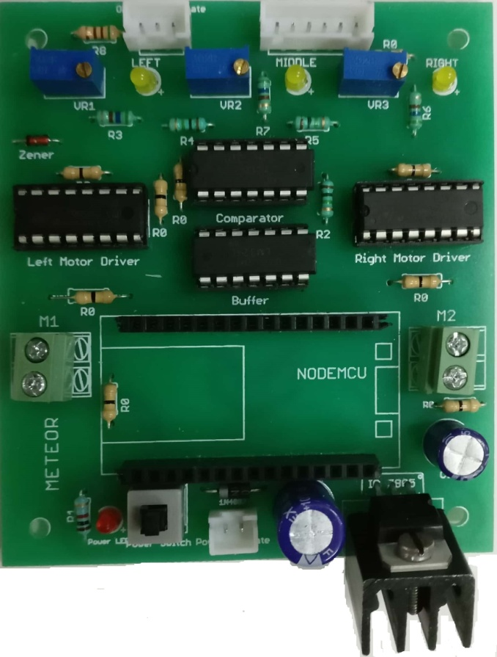
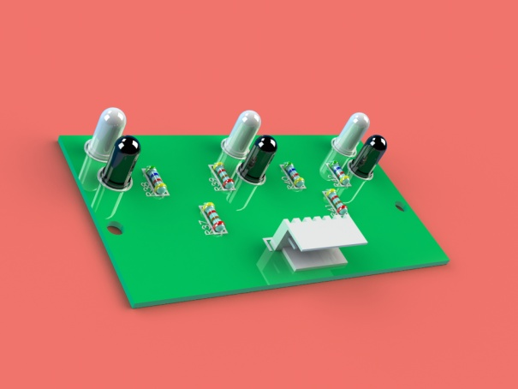
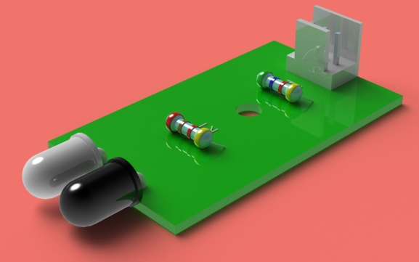
Electronics in the Robot
Obstacle Sensor
Line sensing Array
Motherboard

Slide 15

Sensing

Slide 16
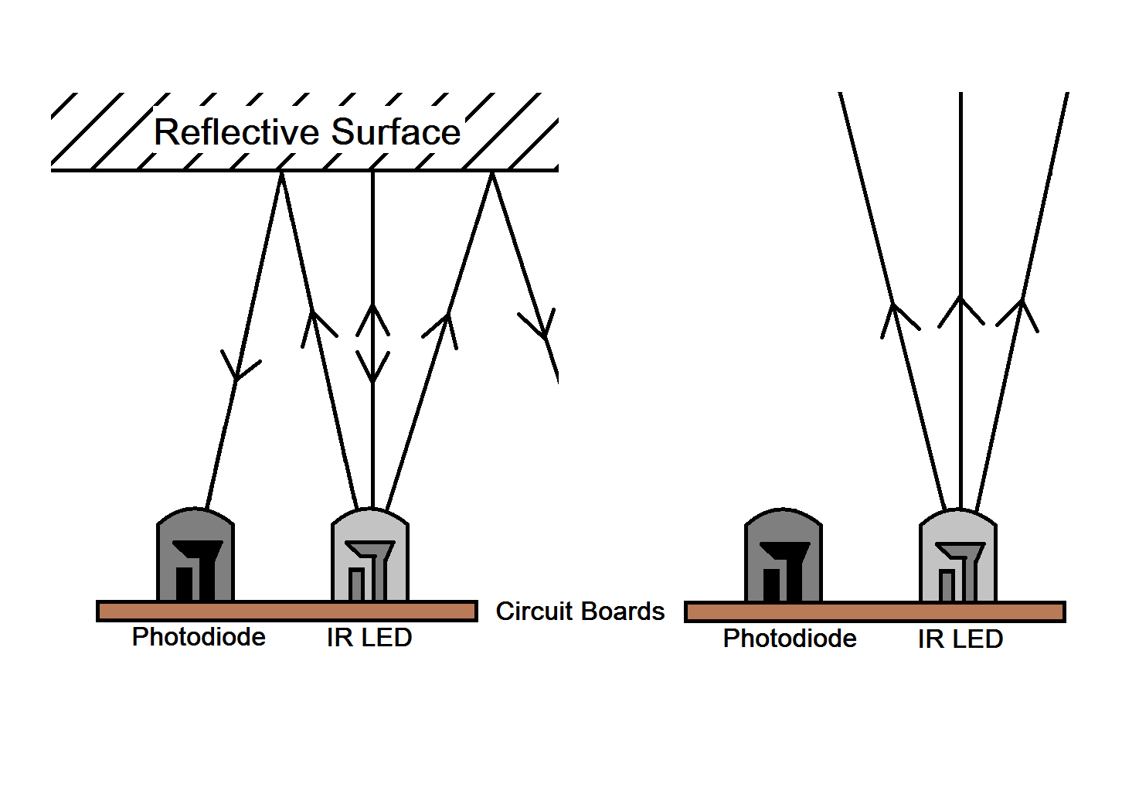
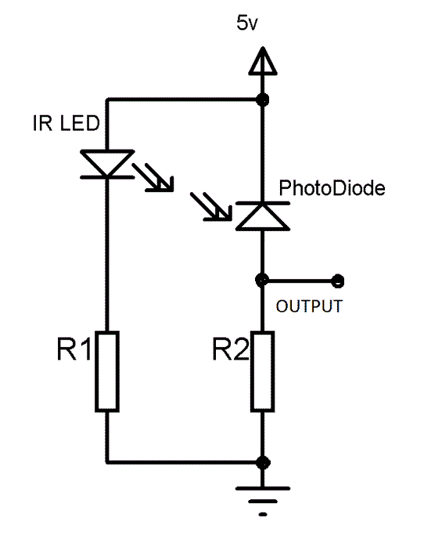
Working of an IR sensor

Slide 17
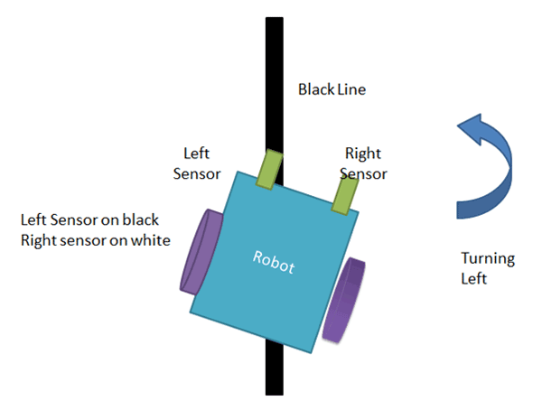
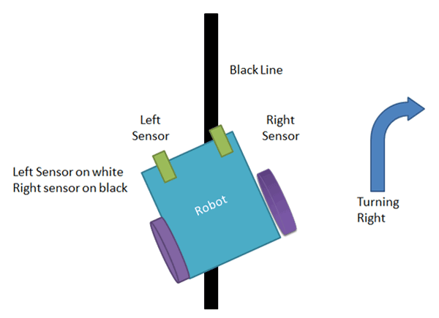
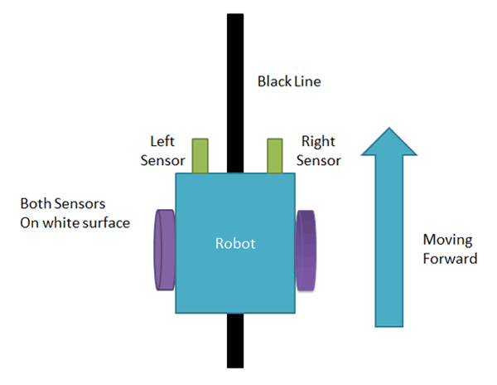
Line Sensing Array

Slide 18
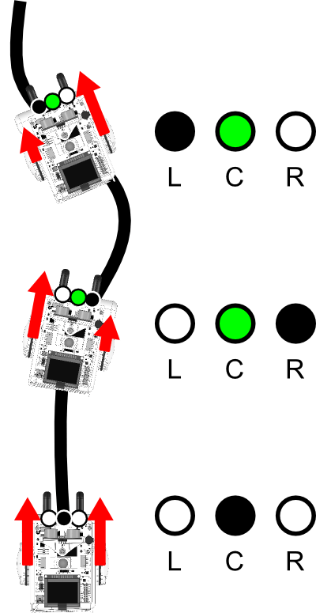

Slide 19

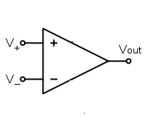
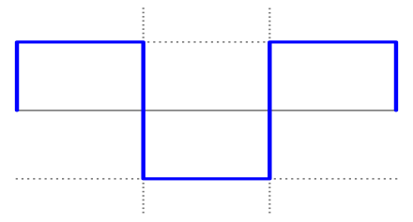
Logical diagram
Sensor Reading
Comparator
Control Unit
Reference voltage

Slide 20
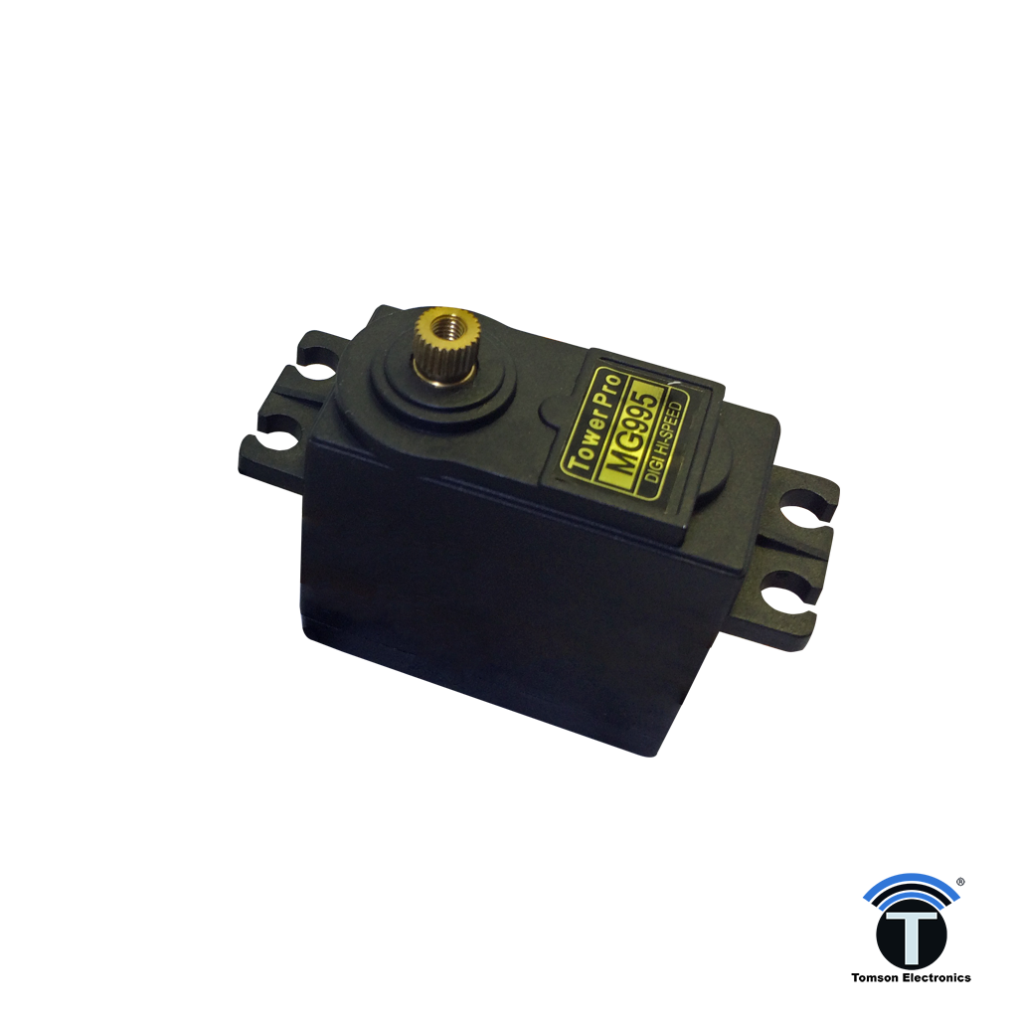
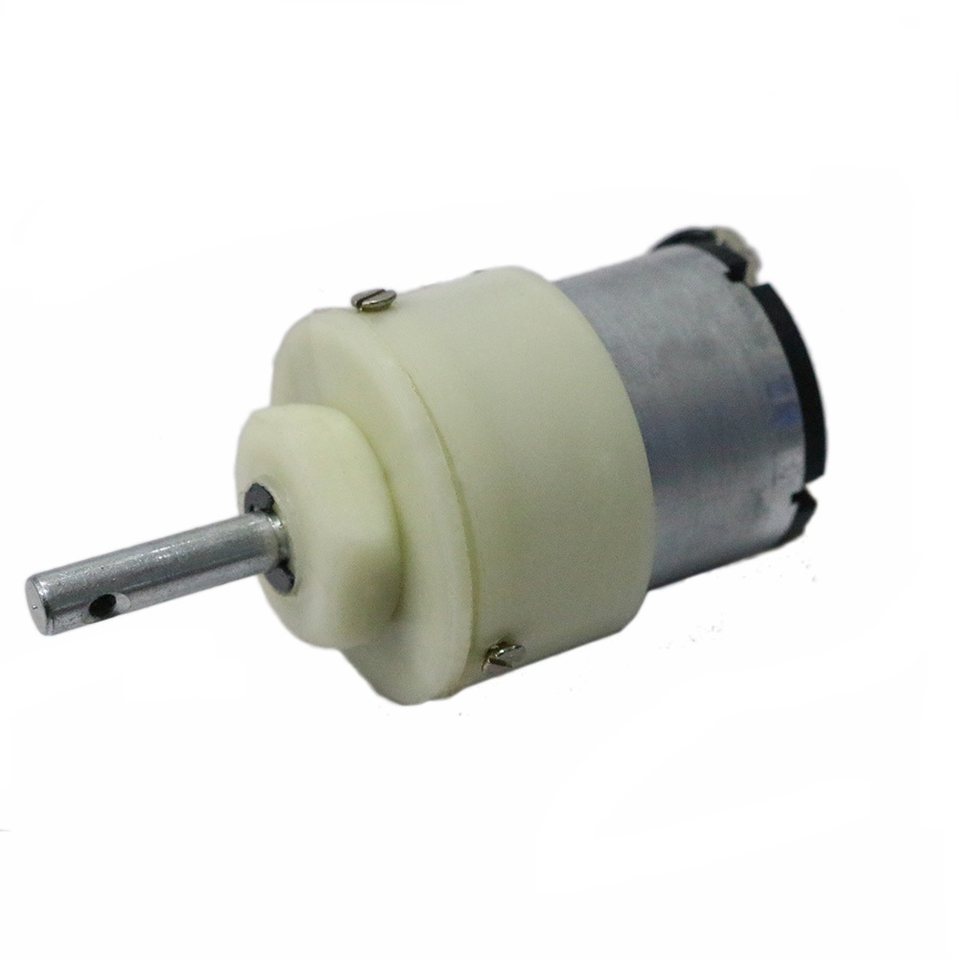
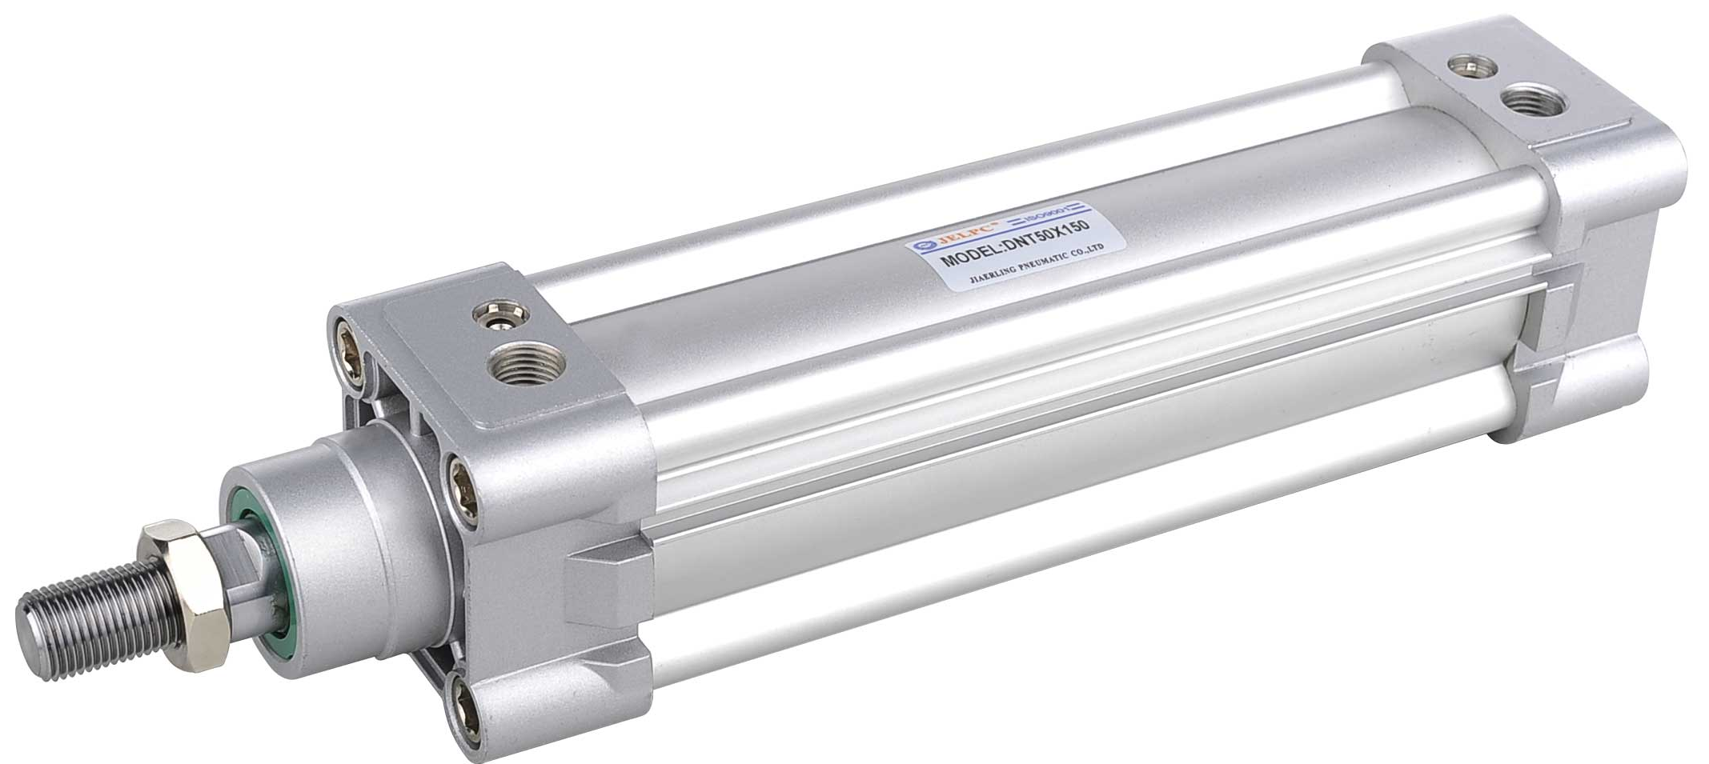
Actuators

Slide 21

Driving Circuit

Slide 22
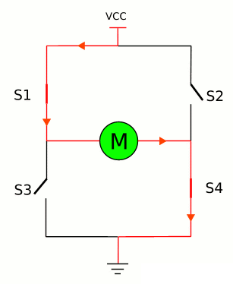
H bridge

Slide 23
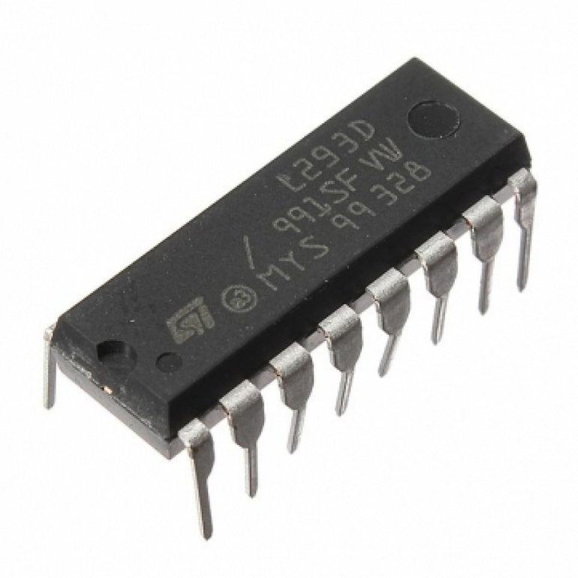
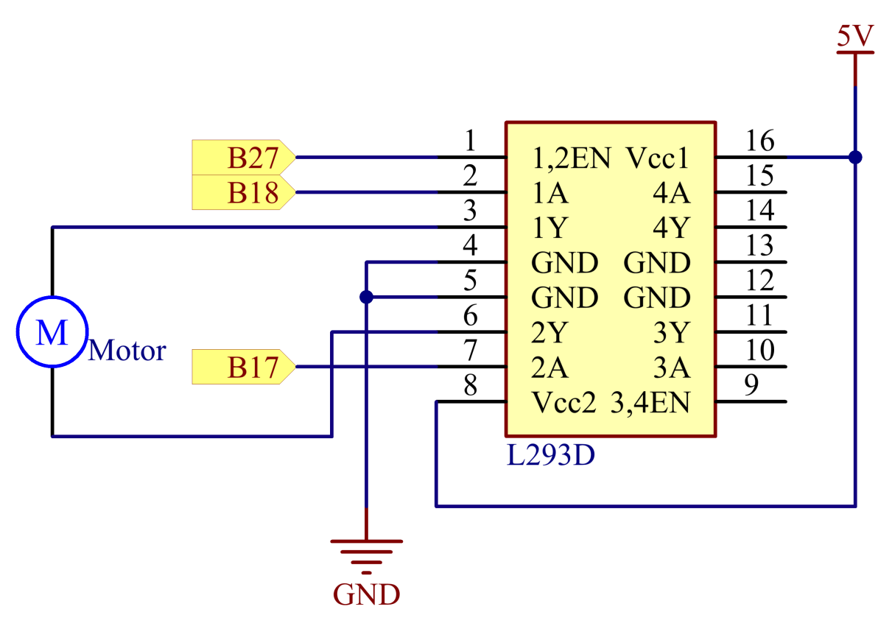
Motor Driver : L293D

Slide 24
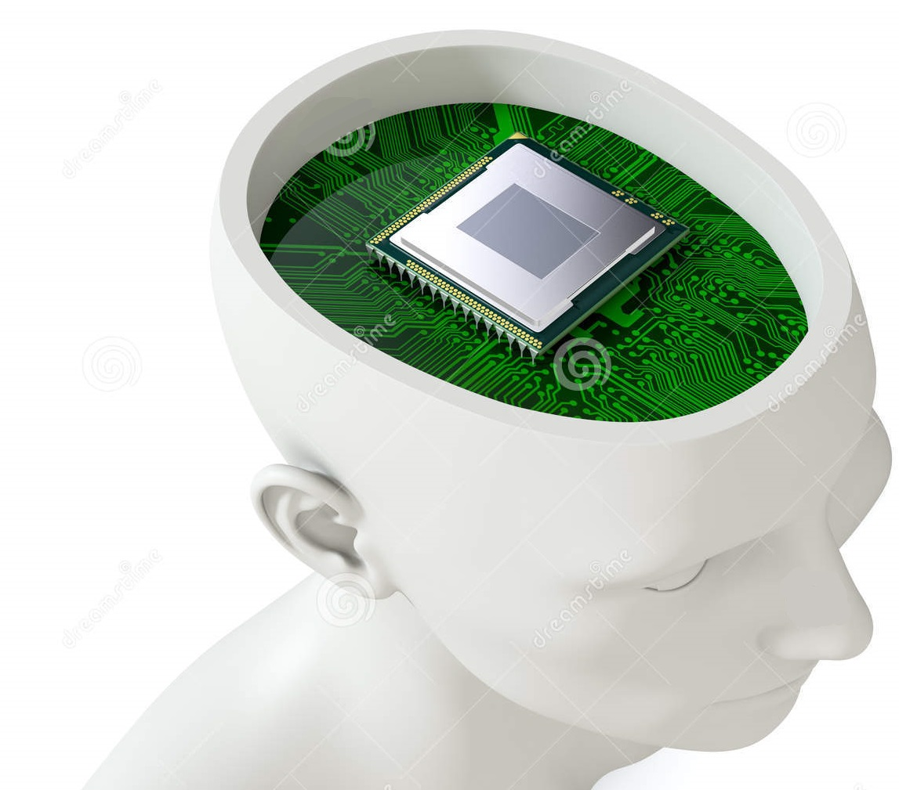
Brains : Microcontroller

Slide 25
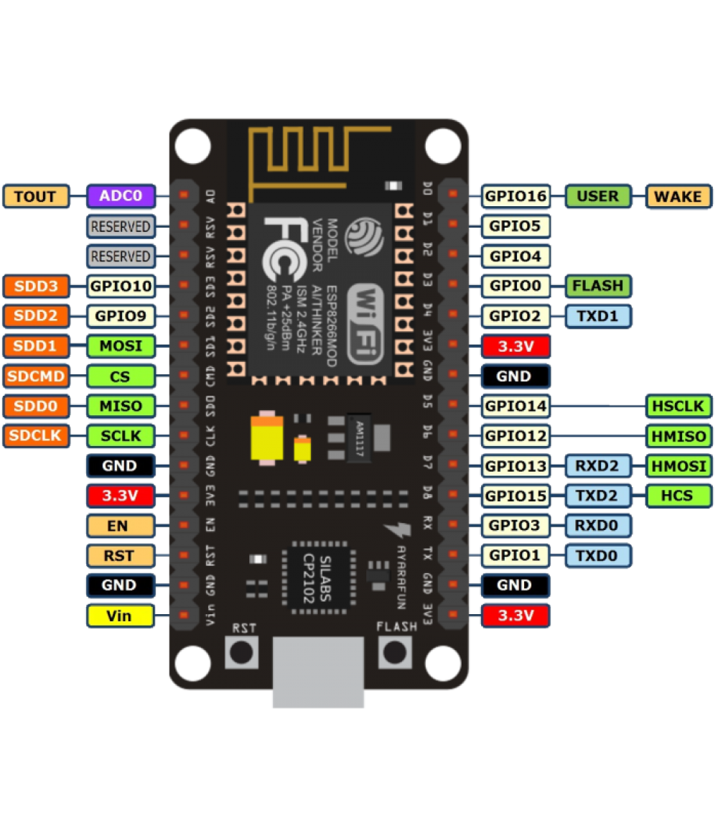
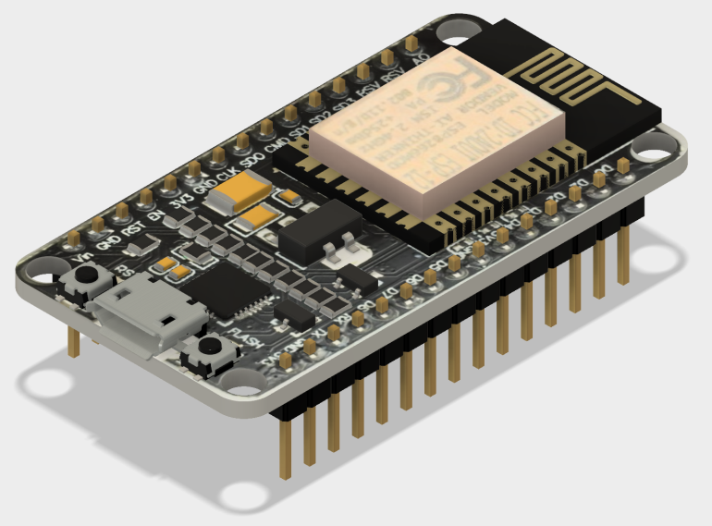
Node MCU

Slide 26
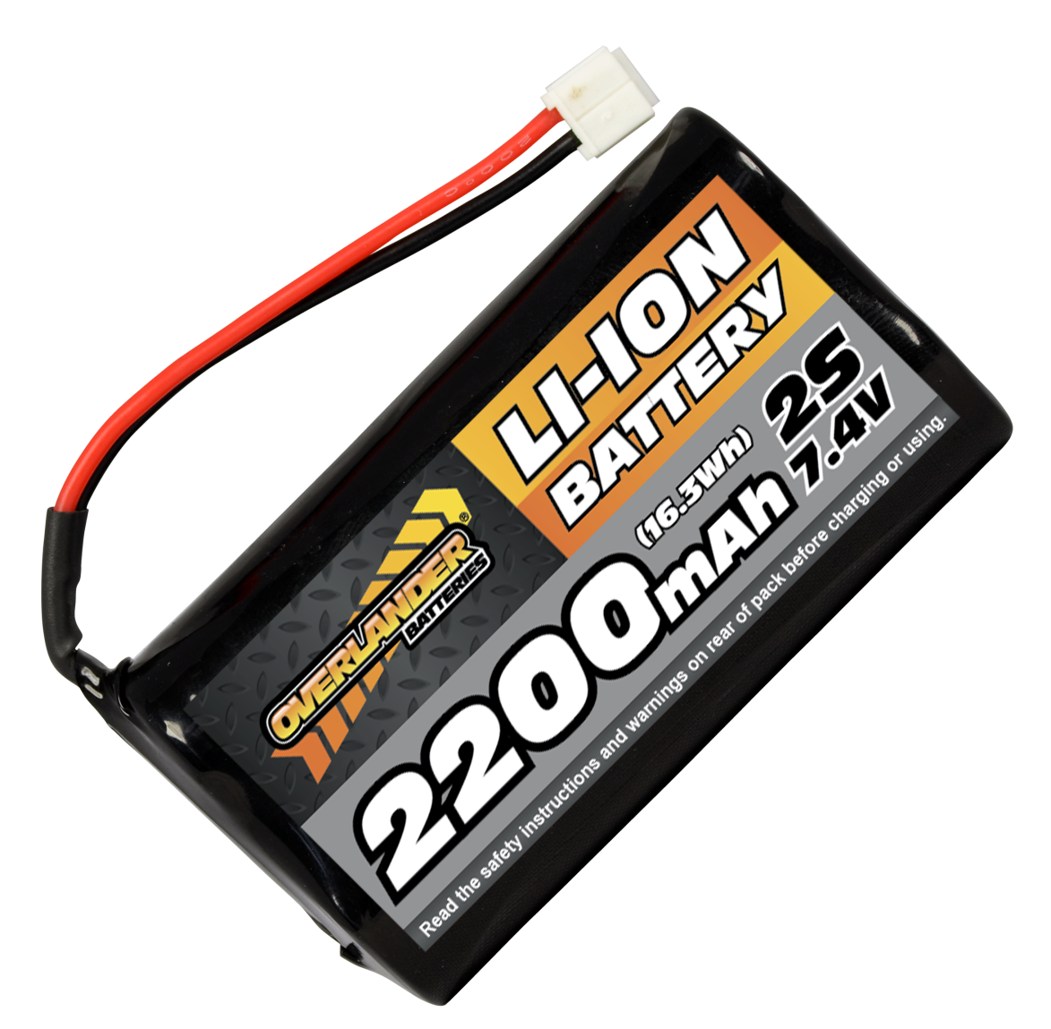
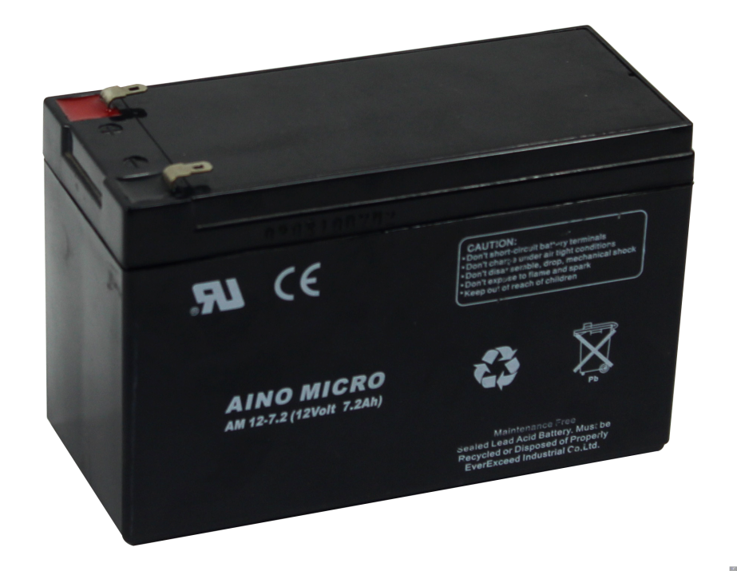
Batteries
Lithium-Ion
Lead-Acid

Slide 27

What else can I do with this robot?

Slide 28

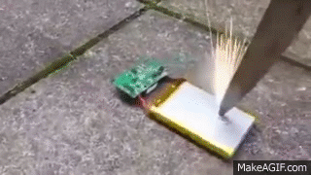
Caution!!
Do not connect anything until you have thorough knowledge.
Batteries are no toys to play with!

Slide 29

Queries?

Slide 30
Thank You!

